Slide 1
GRADE 7 ACCELERATED · UNIT 3 · LESSON 4
Negative Exponent Law
MA.8.NSO.1.3
I can rewrite a power with a negative exponent using a positive exponent, and evaluate it.
Yesterday the exponents stopped at 0.
Today they keep going — and 5⁻² is not a negative number.
Grade 7 Accelerated · Unit 3 · Lesson 4 — Negative Exponent Law
1

Slide 2




Warm-Up
On your own. Four minutes. No notes.
1. Find the value:
2. Which is greater,
or 5.5?
3. Solve
4. What is the reciprocal of
? What is the opposite of
?
Grade 7 Accelerated · Unit 3 · Lesson 4 — Negative Exponent Law
2

Slide 3


Warm-Up
Answers.
1. Find the value:
25
2. Which is greater,
or 5.5?
5.5
3. Solve
x = −7
4. What is the reciprocal of
? What is the opposite of
?
and
Grade 7 Accelerated · Unit 3 · Lesson 4 — Negative Exponent Law
3

Slide 4
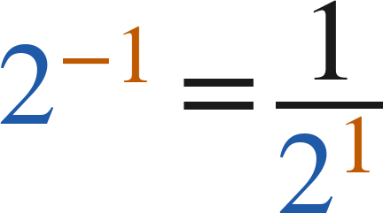
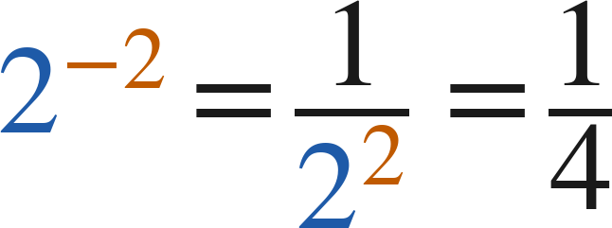
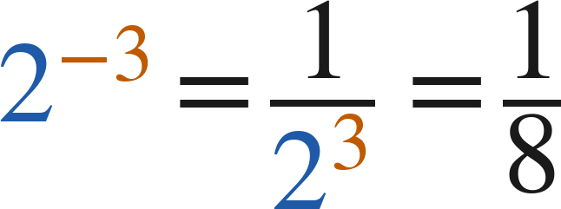
Notes
Copy the table.
I. The pattern keeps going past zero
2⁴ | 2³ | 2² | 2¹ | 2⁰ | 2⁻¹ | 2⁻² | 2⁻³
16 | 8 | 4 | 2 | 1 | 1/2 | 1/4 | 1/8
Grade 7 Accelerated · Unit 3 · Lesson 4 — Negative Exponent Law
4

Slide 5
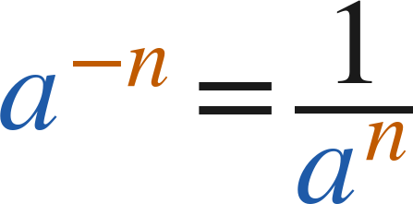
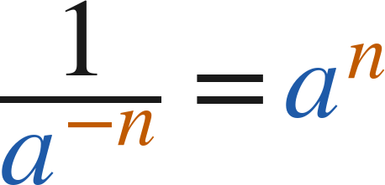

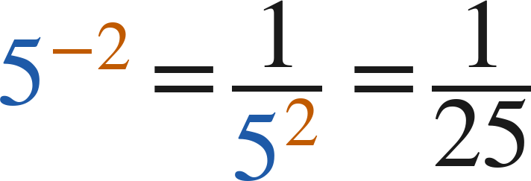
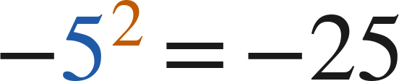

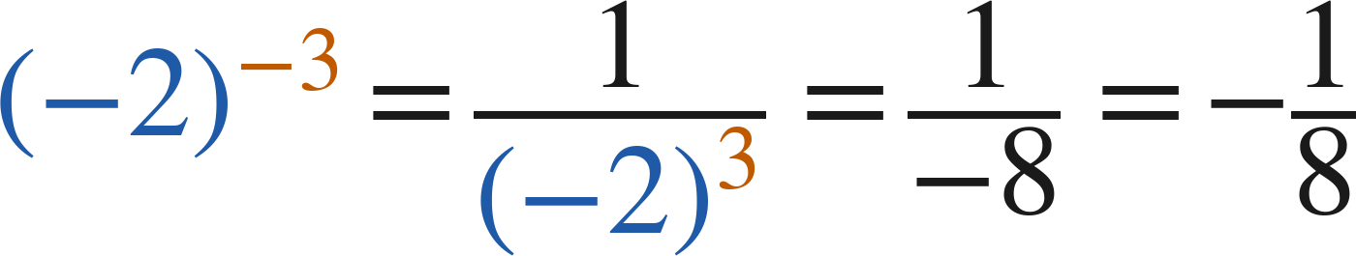
Notes
II. The negative exponent law
(
)
but
and
A negative exponent means reciprocal. It never means a negative value.
The base keeps its own sign:
Grade 7 Accelerated · Unit 3 · Lesson 4 — Negative Exponent Law
5

Slide 6

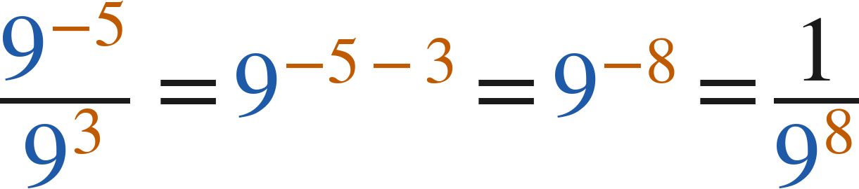
Notes
III. The laws still work with negative exponents
or
Add, subtract and multiply exponents exactly as before — the exponents are just integers now.
Grade 7 Accelerated · Unit 3 · Lesson 4 — Negative Exponent Law
6

Slide 7

Example 1
Negative exponents top and bottom.
Rewrite with positive exponents, then find the value.
Grade 7 Accelerated · Unit 3 · Lesson 4 — Negative Exponent Law
7

Slide 8
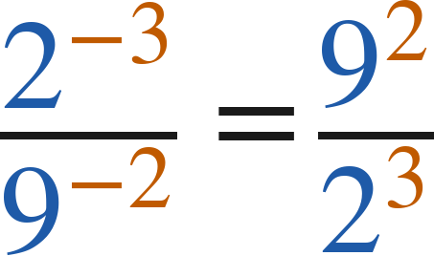
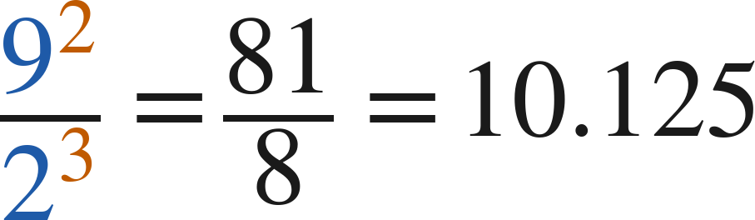
Example 1
Worked.
each power swaps sides and loses the minus
evaluate
Answer: 81/8 = 10.125
Grade 7 Accelerated · Unit 3 · Lesson 4 — Negative Exponent Law
8

Slide 9

Your Turn
Same steps, your numbers. Boards up when done.
Grade 7 Accelerated · Unit 3 · Lesson 4 — Negative Exponent Law
9

Slide 10
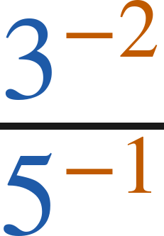

Your Turn
Answer.
swap sides, positive exponents: 5¹ over 3²
Answer:
Grade 7 Accelerated · Unit 3 · Lesson 4 — Negative Exponent Law
10

Slide 11

Example 2
A quotient law crossing zero.
Find the value.
Grade 7 Accelerated · Unit 3 · Lesson 4 — Negative Exponent Law
11

Slide 12
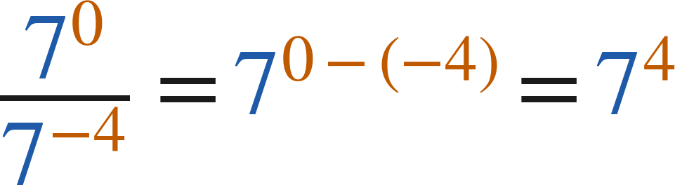
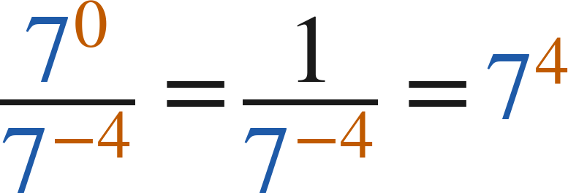

Example 2
Worked both ways.
quotient of powers: 0 − (−4) = 4
zero exponent, then move 7⁻⁴ up
evaluate
Answer: 2,401
Grade 7 Accelerated · Unit 3 · Lesson 4 — Negative Exponent Law
12

Slide 13

Your Turn
Same steps, your numbers. Boards up when done.
Grade 7 Accelerated · Unit 3 · Lesson 4 — Negative Exponent Law
13

Slide 14
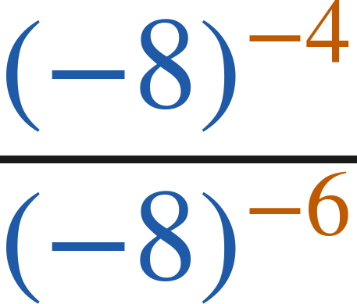
Your Turn
Answer.
−4 − (−6) = 2, so (−8)²
Answer: 64
Grade 7 Accelerated · Unit 3 · Lesson 4 — Negative Exponent Law
14

Slide 15

Whiteboards · Question 1 of 9
Boards up on three.
Answer it.
Rewrite with a positive exponent.
Grade 7 Accelerated · Unit 3 · Lesson 4 — Negative Exponent Law
15

Slide 16


Whiteboards · Question 1 of 9
Answer.
reciprocal of 8³
Answer:
Grade 7 Accelerated · Unit 3 · Lesson 4 — Negative Exponent Law
16

Slide 17

Whiteboards · Question 2 of 9
Boards up on three.
A pollen grain's mass is
microgram.
Its width is 25 micrometers.
What is the value of
?
Answer it.
Find the value.
Grade 7 Accelerated · Unit 3 · Lesson 4 — Negative Exponent Law
17

Slide 18


Whiteboards · Question 2 of 9
Answer.
A pollen grain's mass is
microgram.
Its width is 25 micrometers.
What is the value of
?
1 over 2⁷
Answer:
Grade 7 Accelerated · Unit 3 · Lesson 4 — Negative Exponent Law
18

Slide 19

Whiteboards · Question 3 of 9
Boards up on three.
Answer it.
Rewrite with a positive exponent, then find the value.
Grade 7 Accelerated · Unit 3 · Lesson 4 — Negative Exponent Law
19

Slide 20
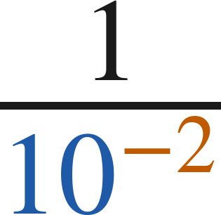
Whiteboards · Question 3 of 9
Answer.
the power moves up: 10²
Answer: 10² = 100
Grade 7 Accelerated · Unit 3 · Lesson 4 — Negative Exponent Law
20

Slide 21

Whiteboards · Question 4 of 9
Boards up on three.
Answer it.
Find the value.
Grade 7 Accelerated · Unit 3 · Lesson 4 — Negative Exponent Law
21

Slide 22
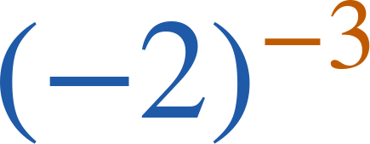

Whiteboards · Question 4 of 9
Answer.
1 over (−2)³ = 1 over −8
Answer:
Grade 7 Accelerated · Unit 3 · Lesson 4 — Negative Exponent Law
22

Slide 23

Whiteboards · Question 5 of 9
Boards up on three.
Which is the value?
A. 1/25
B. −25
C. −10
D. 1/10
Answer it.
Grade 7 Accelerated · Unit 3 · Lesson 4 — Negative Exponent Law
23

Slide 24
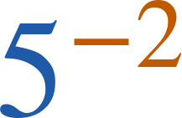
Whiteboards · Question 5 of 9
Answer.
Which is the value?
A. 1/25
B. −25
C. −10
D. 1/10
Answer: A — 1/25
Grade 7 Accelerated · Unit 3 · Lesson 4 — Negative Exponent Law
24

Slide 25

Whiteboards · Question 6 of 9
Boards up on three.
Which expression is equivalent?
A. 6³
B. 6⁻⁷
C. 6⁻¹⁰
D. 36³
Answer it.
Grade 7 Accelerated · Unit 3 · Lesson 4 — Negative Exponent Law
25

Slide 26

Whiteboards · Question 6 of 9
Answer.
Which expression is equivalent?
A. 6³
B. 6⁻⁷
C. 6⁻¹⁰
D. 36³
Answer: A — 6³
Grade 7 Accelerated · Unit 3 · Lesson 4 — Negative Exponent Law
26

Slide 27

Whiteboards · Question 7 of 9
Boards up on three.
Answer it.
Find the value.
Grade 7 Accelerated · Unit 3 · Lesson 4 — Negative Exponent Law
27

Slide 28

Whiteboards · Question 7 of 9
Answer.
3⁰
Answer: 1
Grade 7 Accelerated · Unit 3 · Lesson 4 — Negative Exponent Law
28

Slide 29

Whiteboards · Question 8 of 9
Boards up on three.
Answer it.
Write it as one power with a positive exponent.
Grade 7 Accelerated · Unit 3 · Lesson 4 — Negative Exponent Law
29

Slide 30
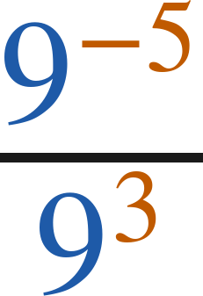

Whiteboards · Question 8 of 9
Answer.
9⁻⁸
Answer:
Grade 7 Accelerated · Unit 3 · Lesson 4 — Negative Exponent Law
30

Slide 31

Whiteboards · Question 9 of 9
Take your time. Boards up when you have written it.
Ellen says the value of
is −25.
Explain why she is wrong, and show the correct value.
Write your answer in sentences.
Use the word reciprocal.
Grade 7 Accelerated · Unit 3 · Lesson 4 — Negative Exponent Law
31

Slide 32
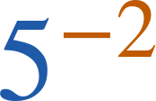
Whiteboards · Question 9 of 9
Answer.
Ellen says the value of
is −25.
Explain why she is wrong, and show the correct value.
reciprocal, not opposite
Answer: 5⁻² = 1/5² = 1/25
Grade 7 Accelerated · Unit 3 · Lesson 4 — Negative Exponent Law
32

Slide 33
Independent Set
Six questions. On your own, in silence.
1.
Six questions. Work down the page.
2.
Show the step that does the work, not just the answer.
3.
Silence until the six minutes are up.
Grade 7 Accelerated · Unit 3 · Lesson 4 — Negative Exponent Law
33

Slide 34
IXL
Last five minutes.
1.
Open IXL and start today's skills.
2.
Work on paper where the question needs work. The answer box does not show it.
3.
Every skill listed is required, to a SmartScore of 67. Due at the start of the next class.
Today's skills — all required
Understanding negative exponents — YBB
Evaluate powers with negative exponents — WGS
Grade 7 Accelerated · Unit 3 · Lesson 4 — Negative Exponent Law
34

